Slide 1
Evaluation Metrics of Classification
B. Ujwala
Asst. Professor, CSE Dept
Anurag University

Slide 2
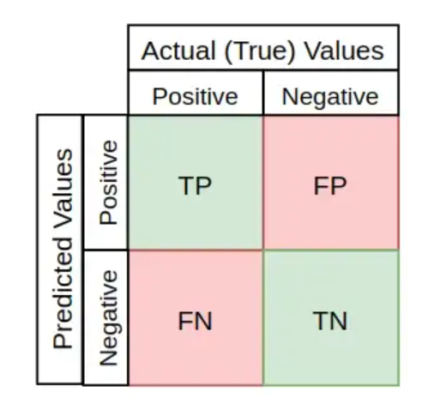
Confusion Matrix
A confusion matrix is used to illustrate classifier performance based on the four values (TP, FP, TN, FN).

Slide 3
TP, FP, TN & FN
True positives: data points labeled as positive that are actually positive
False positives: data points labeled as positive that are actually negative
True negatives: data points labeled as negative that are actually negative
False negatives: data points labeled as negative that are actually positive

Slide 4
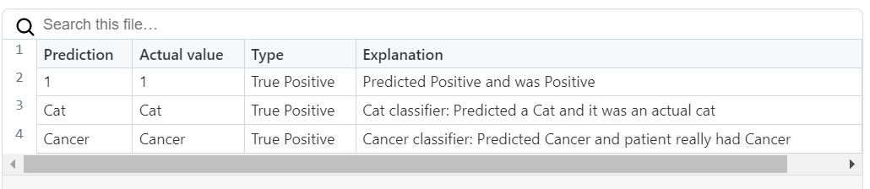
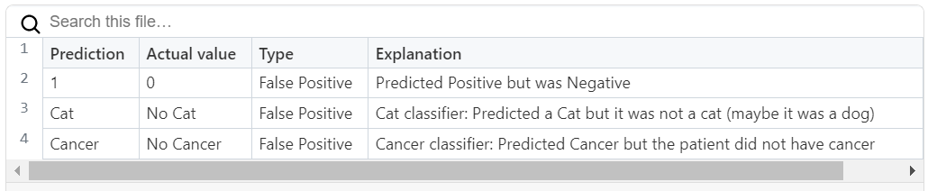
TP, FP

Slide 5
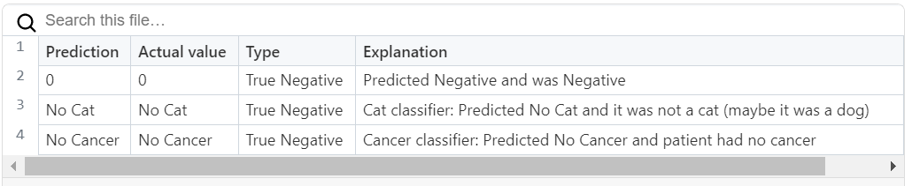
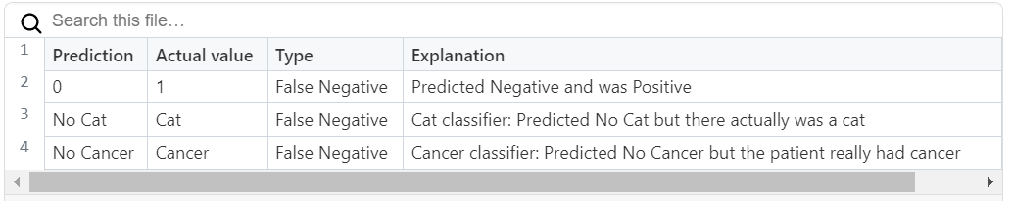
TN, FN

Slide 6
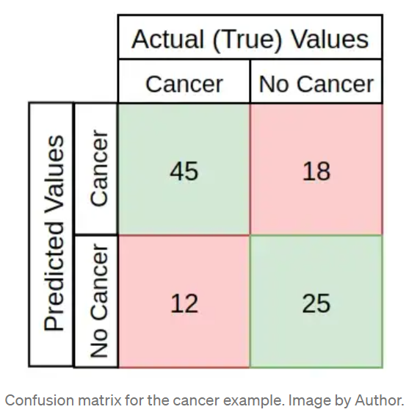
Example
Using the cancer prediction example, a confusion matrix for 100 patients might look something like this:
This example has:
TP: 45 positive cases correctly predicted
TN: 25 negative cases correctly predicted
FP: 18 negative cases are misclassified (wrong positive predictions)
FN: 12 positive cases are misclassified (wrong negative predictions)

Slide 7
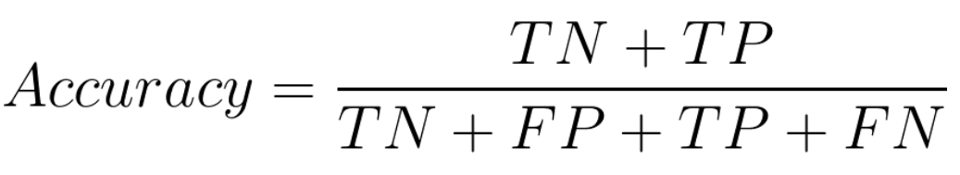
Accuracy:
Accuracy represents the number of correctly classified data instances over the total number of data instances.
Accuracy is not a good metric when the data set is unbalanced. Using accuracy in such scenarios can result in misleading interpretation of results.

Slide 8
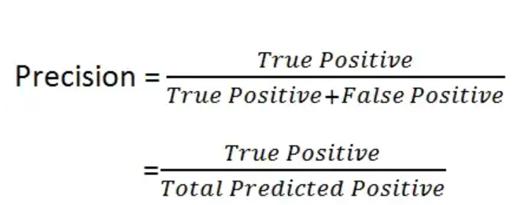
Precision
Precision: the ability of a classification model to return only the data points in a class

Slide 9
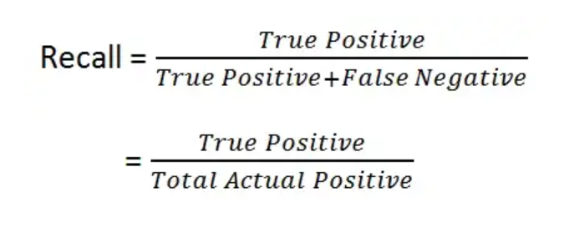
Recall
Recall: the ability of a classification model to identify all data points in a relevant class

Slide 10
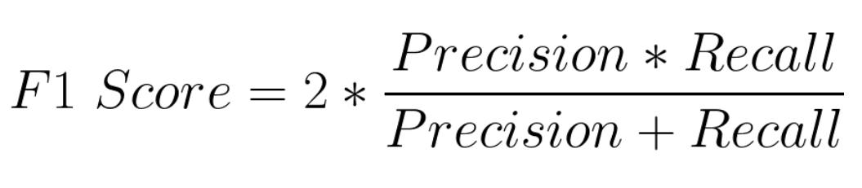
F1 Score
F1 score is the harmonic mean of precision and recall and is a better measure than accuracy.

Slide 11
Recall: the ability of a classification model to identify all data points in a relevant class
Precision: the ability of a classification model to return only the data points in a class
F1 score: a single metric that combines recall and precision using the harmonic mean

Slide 12
Accuracy:
Accuracy represents the number of correctly classified data instances over the total number of data instances.
Accuracy is not a good metric when the data set is unbalanced. Using accuracy in such scenarios can result in misleading interpretation of results.

